Slide 1
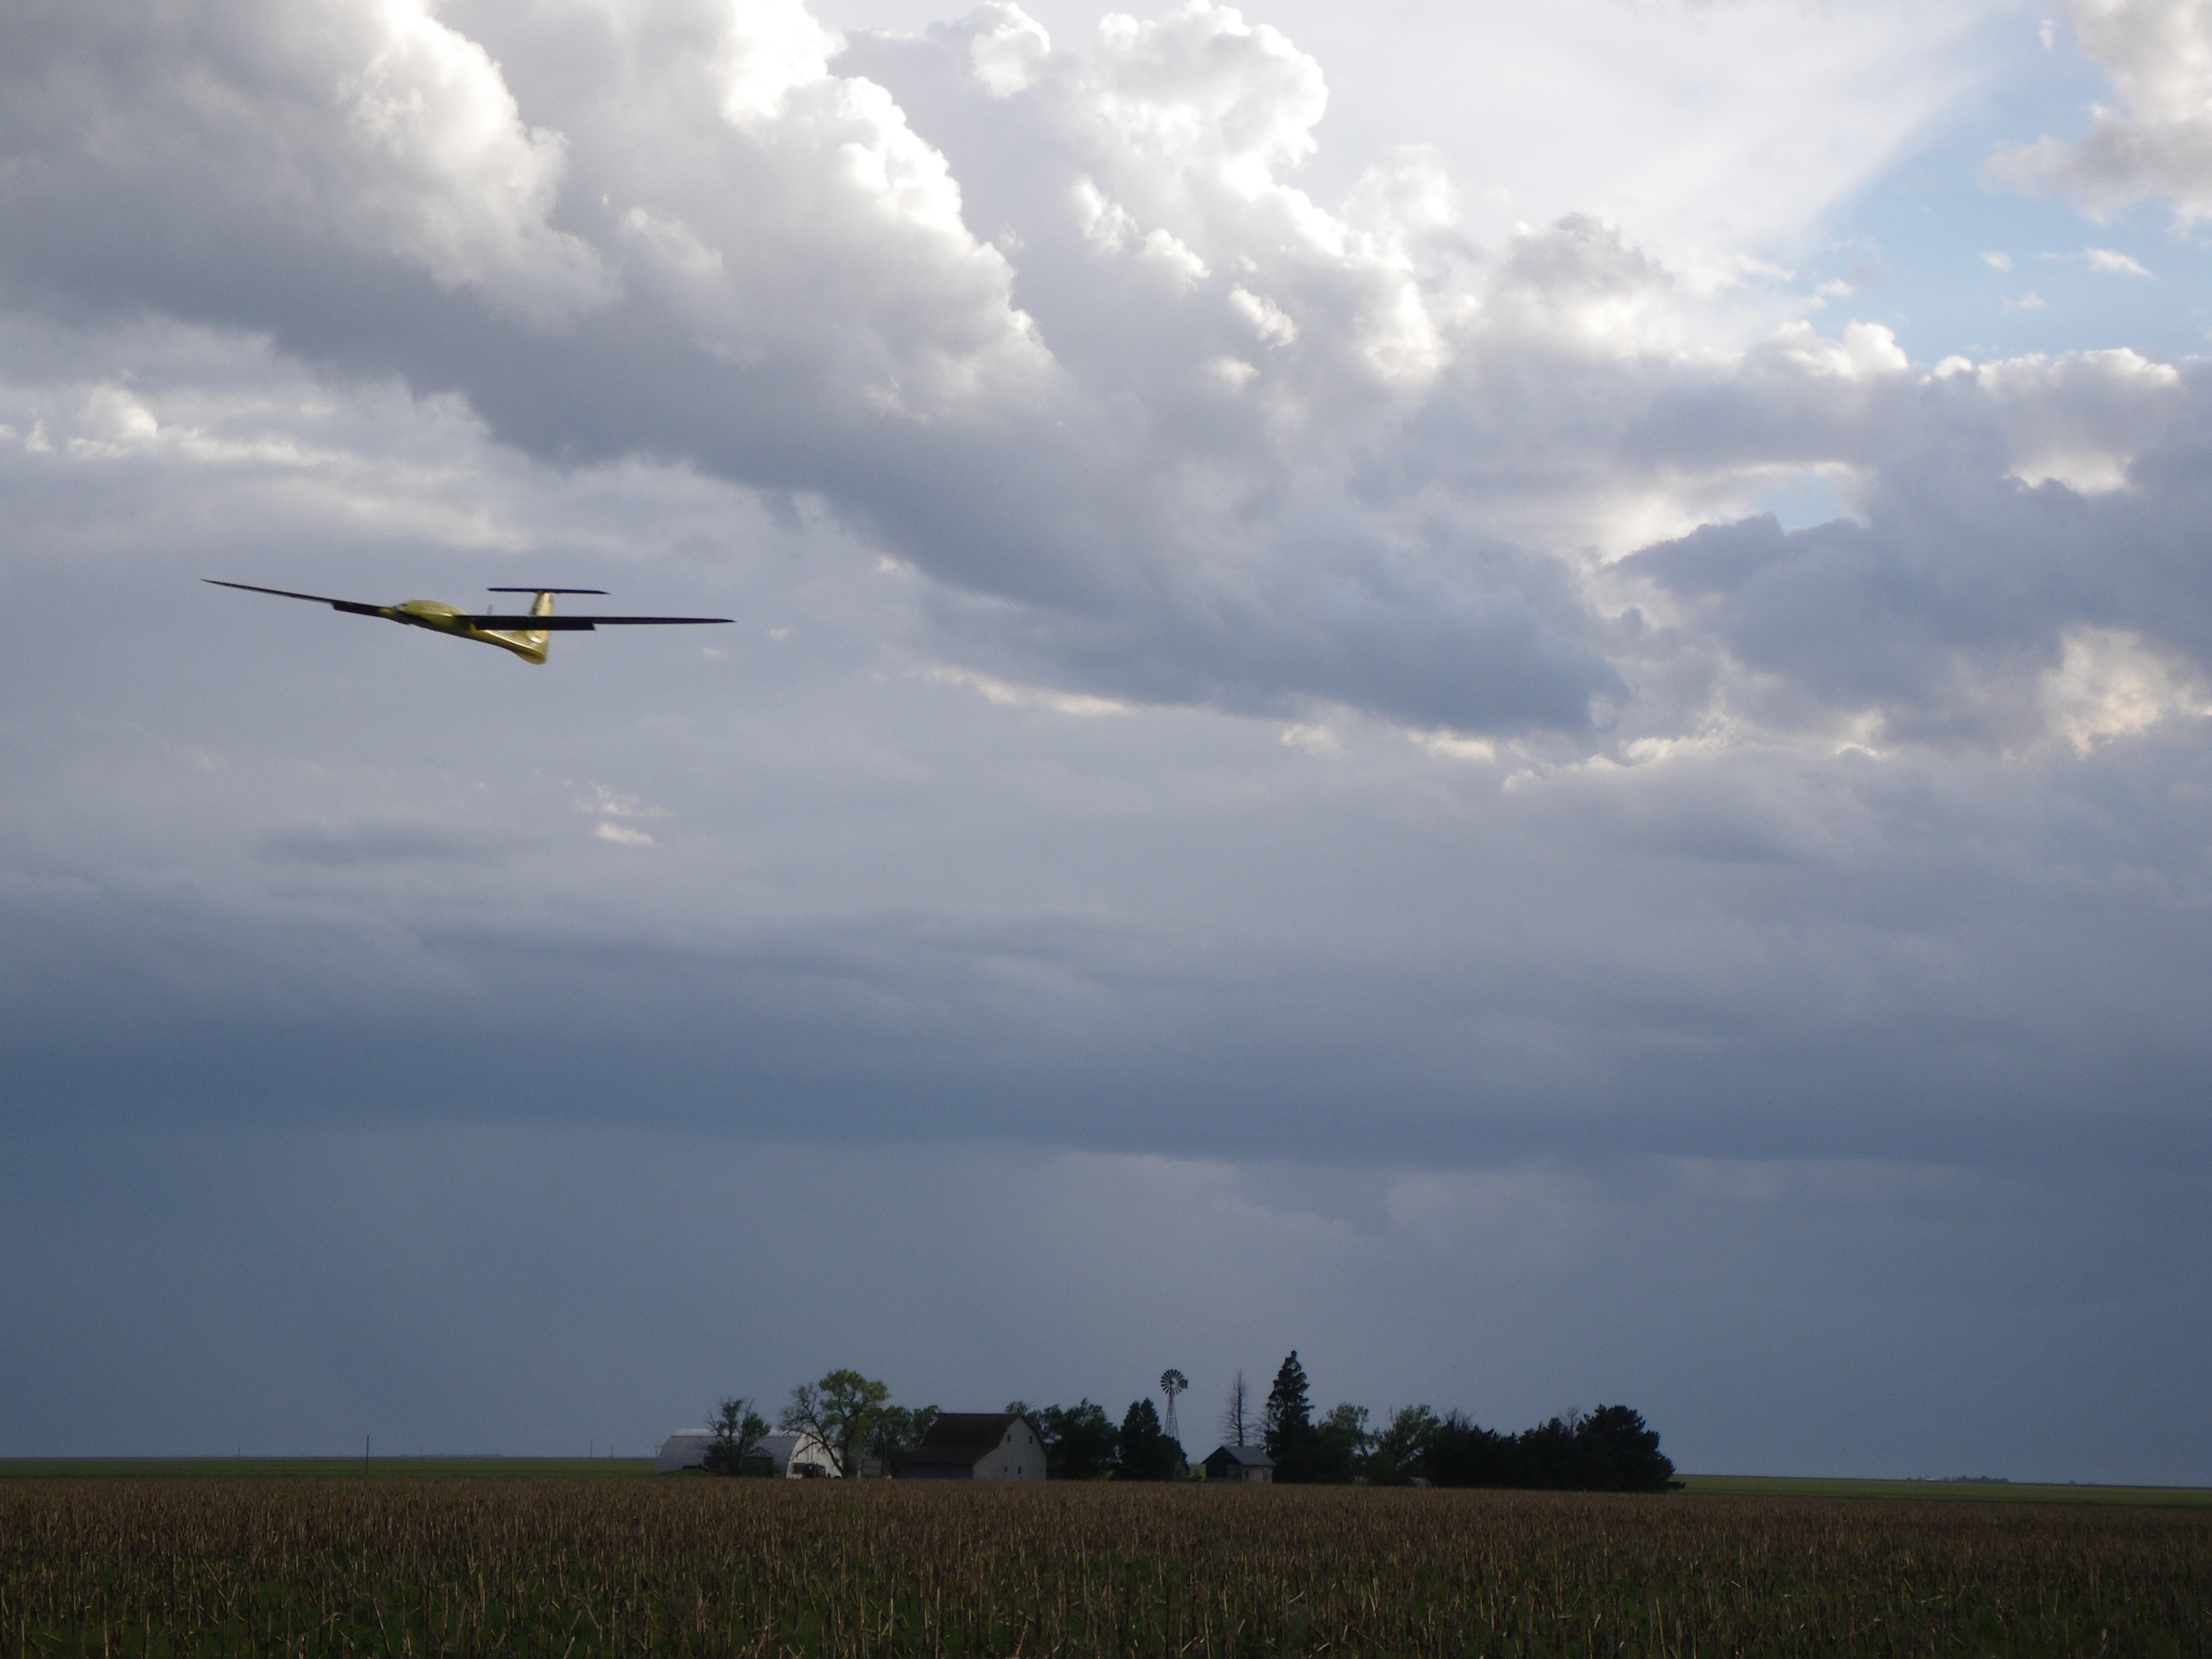
Chapter 3
Kinematics and Dynamics

Slide 2
Aircraft State Variables
Notes:
% Goal of next two chapters is to write equations of motion in the form:
% xdot = f(x,u)
% where x is our state vector and u is our input vector
% What are states?
% What are inputs?
\begin{table}
\centering
\begin{tabular}{|c|l|}
\hline
Name & Description \\
\hline \hline
$p_n$ & Inertial north position of MAV expressed along $\mathbf{i}^i$ in $\mathcal{F}^i$\\ \hline
$p_e$ & Inertial east position of MAV expressed along $\mathbf{j}^i$ in $\mathcal{F}^i$\\ \hline
$p_d$ & Inertial down position of MAV expressed along $\mathbf{k}^i$ in $\mathcal{F}^i$\\ \hline
$u$ & Ground velocity expressed along $\mathbf{i}^b$ in $\mathcal{F}^b$\\ \hline
$v$ & Ground velocity expressed along $\mathbf{j}^b$ in $\mathcal{F}^b$\\ \hline
$w$ & Ground velocity expressed along $\mathbf{k}^b$ in $\mathcal{F}^b$\\ \hline
$\phi$ & Roll angle defined with respect to $\mathcal{F}^{v2}$\\ \hline
$\theta$ & Pitch angle defined with respect to $\mathcal{F}^{v1}$\\ \hline
$\psi$ & Heading (yaw) angle defined with respect to $\mathcal{F}^v$ \\ \hline
$p$ & Body angular (roll) rate expressed along $\mathbf{i}^b$ in $\mathcal{F}^b$ \\ \hline
$q$ & Body angular (pitch) rate expressed along $\mathbf{j}^b$ in $\mathcal{F}^b$ \\ \hline
$r$ & Body angular (yaw) rate expressed along $\mathbf{k}^b$ in $\mathcal{F}^b$ \\
\hline
\end{tabular}
\end{table}

Slide 3
Translational Kinematics
Notes:
\begin{pmatrix} \dot{p}_n \\ \dot{p}_e \\ \dot{p}_d \end{pmatrix} &\stackrel{\triangle}{=}
\frac{d}{dt} \begin{pmatrix} p_n \\ p_e \\ p_d \end{pmatrix} = \mathbf{v}^v = R_b^v \mathbf{v}^b \\
&=R_{b}^{v} \begin{pmatrix} u \\ v \\ w \end{pmatrix} \\
&= (R_{v}^{b})^{\top} \begin{pmatrix} u \\ v \\ w \end{pmatrix}
\\
&= \begin{pmatrix} \cth \cps & \sph \sth \cps - \cph \sps
& \cph \sth \cps + \sph \sps \\
\cth \sps & \sph \sth \sps + \cph \cps
& \cph \sth \sps - \sph \cps \\
-\sth & \sph \cth & \cph \cth
\end{pmatrix}
\begin{pmatrix} u \\ v \\ w \end{pmatrix}

Slide 4
Rotational Kinematics
Inverting gives:
Notes:
\begin{pmatrix} p \\ q \\ r \end{pmatrix} &=
\underbrace{\begin{pmatrix} \dot{\phi} \\ 0 \\ 0
\end{pmatrix}}_{\dot{\phi} \text{~is defined in~} \mathcal{F}^b}
+ \underbrace{R_{v2}^{b}(\phi)
\begin{pmatrix} 0 \\ \dot{\theta} \\
0 \end{pmatrix}}_{\dot{\theta} \text{~is defined in~} \mathcal{F}^{v2}} + \underbrace{R_{v2}^{b}(\phi) R_{v1}^{v2}(\theta)
\begin{pmatrix} 0 \\ 0 \\ \dot{\psi} \end{pmatrix}}_{\dot{\psi} \text{~is defined in~} \mathcal{F}^{v1}} \notag \\
&= \begin{pmatrix} \dot{\phi} \\ 0 \\ 0 \end{pmatrix}
+ \begin{pmatrix}
1 & 0 & 0 \\
0 & \cos\phi & \sin\phi \\
0 & -\sin\phi & \cos\phi
\end{pmatrix}
\begin{pmatrix} 0 \\ \dot{\theta} \\ 0 \end{pmatrix}
+ \begin{pmatrix}
1 & 0 & 0 \\
0 & \cos\phi & \sin\phi \\
0 & -\sin\phi & \cos\phi
\end{pmatrix}
\begin{pmatrix}
\cos\theta & 0 & -\sin\theta \\
0 & 1 & 0 \\
\sin\theta & 0 & \cos\theta
\end{pmatrix}
\begin{pmatrix} 0 \\ 0 \\ \dot{\psi} \end{pmatrix} \notag \\
&= \begin{pmatrix}
1 & 0 & -\sin\theta \\
0 & \cos\phi & \sin\phi \cos\theta \\
0 & -\sin\phi & \cos\phi \cos\theta
\end{pmatrix}
\begin{pmatrix} \dot{\phi} \\ \dot{\theta} \\ \dot{\psi} \end{pmatrix}
\begin{pmatrix} \dot{\phi} \\ \dot{\theta} \\ \dot{\psi} \end{pmatrix}
= \begin{pmatrix}
1 & \sin\phi\tan\theta & \cos\phi\tan\theta \\
0 & \cos\phi & -\sin\phi \\
0 & \sin\phi\sec\theta & \cos\phi\sec\theta
\end{pmatrix}
\begin{pmatrix} p \\ q \\ r
\end{pmatrix}

Slide 5
Kinematic Equations of Motion
Notes:
\newcommand{\sth}{\text{s}_\theta}
\newcommand{\cth}{\text{c}_\theta}
\newcommand{\sph}{\text{s}_\phi}
\newcommand{\cph}{\text{c}_\phi}
\newcommand{\sps}{\text{s}_\psi}
\newcommand{\cps}{\text{c}_\psi}
\noindent Six of the 12 state equations for the MAV come from the kinematic \\
equations relating positions and velocities:
\begin{align*}
\begin{pmatrix} \dot{p}_n \\ \dot{p}_e \\ \dot{p}_d \end{pmatrix} &= \begin{pmatrix} \cth \cps & \sph \sth \cps - \cph \sps
& \cph \sth \cps + \sph \sps \\
\cth \sps & \sph \sth \sps + \cph \cps
& \cph \sth \sps - \sph \cps \\
-\sth & \sph \cth & \cph \cth
\end{pmatrix}
\begin{pmatrix} u \\ v \\ w \end{pmatrix}
\\
\begin{pmatrix} \dot{\phi} \\ \dot{\theta} \\ \dot{\psi} \end{pmatrix}
&= \begin{pmatrix}
1 & \sin\phi\tan\theta & \cos\phi\tan\theta \\
0 & \cos\phi & -\sin\phi \\
0 & \sin\phi\sec\theta & \cos\phi\sec\theta
\end{pmatrix}
\begin{pmatrix} p \\ q \\ r
\end{pmatrix}
\end{align*}
\noindent
The remaining six equations will come from applying Newton’s 2nd law
to the translational and rotational motion of the aircraft

Slide 6
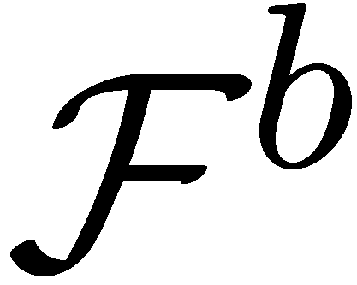


Differentiation of a Vector in Two Reference Frames
Notes:
\par\noindent Define the vector $\mathbf{p}$ in terms of the axes in the body frame:
\[
\mathbf{p} = p_x \mathbf{i}^b + p_y \mathbf{j}^b + p_z \mathbf{k}^b.
\]
Differentiation with respect to the inertial frame gives
\[
\frac{d}{dt_i}\mathbf{p} = \dot{p}_x \mathbf{i}^b + \dot{p}_y \mathbf{j}^b + \dot{p}_z \mathbf{k}^b + p_x \frac{d}{dt_i}\mathbf{i}^b + p_y \frac{d}{dt_i}\mathbf{j}^b + p_z \frac{d}{dt}\mathbf{k_i}^b,
\]
where
\[
\dot{p}_\ast^b = \frac{dp_\ast^b}{dt}.
\]
Let
\[
\frac{d}{dt_b}\mathbf{p} = \dot{p}_x \mathbf{i}^b + \dot{p}_y \mathbf{j}^b + \dot{p}_z \mathbf{k}^b.
\]

Slide 7
Differentiation of a Vector in Two Reference Frames
Notes:
\par\noindent Recall from physics that for any vector $\mathbf{v}$ fixed in $\mathcal{F}^b$ we have
\[
\frac{d}{dt_i}\mathbf{v} = \boldsymbol{\omega}_{b/i} \times \mathbf{v}.
\]
Therefore
\begin{align*}
\frac{d}{dt_i}\mathbf{i}^b &= \boldsymbol{\omega}_{b/i}\times\mathbf{i}^b \\
\frac{d}{dt_i}\mathbf{j}^b &= \boldsymbol{\omega}_{b/i}\times\mathbf{j}^b \\
\frac{d}{dt_i}\mathbf{k}^b &= \boldsymbol{\omega}_{b/i}\times\mathbf{k}^b.
\end{align*}
Therefore
\begin{align*}
p_x \frac{d}{dt_i}\mathbf{i}^b + p_y \frac{d}{dt_i}\mathbf{j}^b + p_z \frac{d}{dt_i}\mathbf{k}^b
&= p_x \boldsymbol{\omega}_{b/i}\times\mathbf{i}^b
+ p_y \boldsymbol{\omega}_{b/i}\times\mathbf{j}^b
+ p_z \boldsymbol{\omega}_{b/i}\times\mathbf{k}^b
\\
&= \boldsymbol{\omega}_{b/i}\times\left(p_x\mathbf{i}^b + p_y\mathbf{j}^b + p_z\mathbf{k}^b\right) \\
&= \boldsymbol{\omega}_{b/i}\times\mathbf{p},
\end{align*}
resulting in
\[
\frac{d}{dt_i}\mathbf{p} = \frac{d}{dt_b}\mathbf{p} + \boldsymbol{\omega}_{b/i}
\times\mathbf{p}.
\]

Slide 8
Translational Dynamics
Notes:
\newcommand{\sth}{\text{s}_\theta}
\newcommand{\cth}{\text{c}_\theta}
\newcommand{\sph}{\text{s}_\phi}
\newcommand{\cph}{\text{c}_\phi}
\newcommand{\sps}{\text{s}_\psi}
\newcommand{\cps}{\text{c}_\psi}
\newcommand{\Vbf}{\mathbf{V}}
\noindent Newton's 2nd Law:
\[
\mass \frac{d\Vbf_g}{dt_i}
= \mathbf{f}
\]
\noindent What is $\mathbf{V}_g$?
\begin{itemize}
\item $\mathbf{f}$ is the sum of all external forces
\item $\mass$ is the mass of the aircraft
\item Time derivative taken in inertial frame
\end{itemize}
\noindent Using the expression
\[
\frac{d\Vbf_g}{dt_i}
= \frac{d\mathbf{V}_g}{dt_b} +
\boldsymbol{\omega}_{b/i}\times\mathbf{V}_g
\]
gives
\[
\mass \left(\frac{d\mathbf{V}_g}{dt_b} +
\boldsymbol{\omega}_{b/i}\times\mathbf{V}_g \right) = \mathbf{f}
\]

Slide 9
Translational Dynamics
Notes:
\newcommand{\sth}{\text{s}_\theta}
\newcommand{\cth}{\text{c}_\theta}
\newcommand{\sph}{\text{s}_\phi}
\newcommand{\cph}{\text{c}_\phi}
\newcommand{\sps}{\text{s}_\psi}
\newcommand{\cps}{\text{c}_\psi}
\newcommand{\mass}{\mathsf{m}}
\newcommand{\Vbf}{\mathbf{V}}
\noindent Expressing
$\mass \left(\frac{d\mathbf{V}_g}{dt_b} +
\boldsymbol{\omega}_{b/i}\times\mathbf{V}_g \right) = \mathbf{f}$
in the body frame gives
\[
\mass \left(\frac{d\mathbf{V}^b_g}{dt_b} +
\boldsymbol{\omega}^b_{b/i}\times\mathbf{V}^b_g \right) = \mathbf{f}^b
\]
where
\[
\mathbf{V}^b_g = \begin{pmatrix} u \\ v \\ w
\end{pmatrix}
\qquad
\boldsymbol{\omega}^b_{b/i} = \begin{pmatrix} p \\ q \\ r
\end{pmatrix}
\qquad
\boldsymbol{f}^b = \begin{pmatrix} f_x \\ f_y \\ f_z
\end{pmatrix}
\]
Since
$\frac{d\mathbf{V}^b_g}{dt_b} = \begin{pmatrix} \dot{u} \\ \dot{v} \\ \dot{w}
\end{pmatrix}$
we have that
\[
\begin{pmatrix} \dot{u} \\ \dot{v} \\ \dot{w} \end{pmatrix}
= -\begin{pmatrix} p \\ q \\ r \end{pmatrix}\times\begin{pmatrix} u \\ v \\ w \end{pmatrix} + \frac{1}{\mass} \begin{pmatrix} f_x \\ f_y \\ f_z \end{pmatrix}
= \begin{pmatrix} rv-qw \\ pw-ru \\ qu-pv \end{pmatrix} +
\frac{1}{\mass} \begin{pmatrix} f_x \\ f_y \\ f_z \end{pmatrix}
\]

Slide 10
Rotational Dynamics
Notes:
\renewcommand{\textwidth}{3in}
\newcommand{\sth}{\text{s}_\theta}
\newcommand{\cth}{\text{c}_\theta}
\newcommand{\sph}{\text{s}_\phi}
\newcommand{\cph}{\text{c}_\phi}
\newcommand{\sps}{\text{s}_\psi}
\newcommand{\cps}{\text{c}_\psi}
\newcommand{\mass}{\mathsf{m}}
\newcommand{\Vbf}{\mathbf{V}}
\noindent Newton's 2nd Law:
\[
\frac{d\mathbf{h}}{dt_i} = \mathbf{m}
\]
\begin{itemize}
\item $\mathbf{h}$ is the angular momentum vector
\item $\mathbf{m}$ is the sum of all external moments
\item Time derivative taken wrt inertial frame
\end{itemize}
\noindent Therefore we have
\[
\frac{d\mathbf{h}}{dt_i}
= \frac{d\mathbf{h}}{dt_b} + \boldsymbol{\omega}_{b/i}\times\mathbf{h} = \mathbf{m}.
\]
Expressing in the body frame gives
\[
\frac{d\mathbf{h}^b}{dt_b} + \boldsymbol{\omega}^b_{b/i}\times\mathbf{h}^b
= \mathbf{m}^b.
\]

Slide 11
Rotational Dynamics
Notes:
\newcommand{\sth}{\text{s}_\theta}
\newcommand{\cth}{\text{c}_\theta}
\newcommand{\sph}{\text{s}_\phi}
\newcommand{\cph}{\text{c}_\phi}
\newcommand{\sps}{\text{s}_\psi}
\newcommand{\cps}{\text{c}_\psi}
%\newcommand{\mass}{\mathsf{m}}
\newcommand{\Vbf}{\mathbf{V}}
%\newcommand{\defeq}{\stackrel{\triangle}{=}}
\noindent For a rigid body, angular momentum is defined as the product of the inertia
matrix and the angular velocity vector:
\[
\mathbf{h}^b \defeq \mathbf{J}\boldsymbol{\omega}_{b/i}^b
\]
\noindent where
\begin{align*}
\mathbf{J} &=
\begin{pmatrix}
\int (y^2 + z^2)\,d\mass & -\int xy\,d\mass & -\int xz\,d\mass \\
-\int xy\,d\mass & \int (x^2 + z^2)\,d\mass & -\int yz\,d\mass \\
-\int xz\,d\mass & -\int yz\,d\mass & \int (x^2 + y^2)\,d\mass
\end{pmatrix} \label{eq:kinematics-J}\\
&\defeq
\begin{pmatrix}
J_{x} & -J_{xy} & -J_{xz} \\
-J_{xy} & J_{y} & -J_{yz} \\
-J_{xz} & -J_{yz} & J_{z}
\end{pmatrix}
\end{align*}
\noindent Diagonal elements are called moments of inertia. Off-diagonal
elements are called products of inertia
\vspace{.5cm}
\noindent $\mathbf{J}$ determined from mass properties in CAD program or measured
experimentally using a bifilar pendulum

Slide 12
Rotational Dynamics
Notes:
\noindent Recalling that
\[
\frac{d\mathbf{h}^b}{dt_b} + \boldsymbol{\omega}^b_{b/i}\times\mathbf{h}^b
= \mathbf{m}^b
\]
\noindent Because $\mathbf{J}$ is unchanging in the body frame, $\frac{d\mathbf{J}}{dt_b} = 0$ and
\[
\mathbf{J} \frac{d\boldsymbol{\omega}_{b/i}^b}{dt_b}
+ \boldsymbol{\omega}^b_{b/i}\times \left( \mathbf{J} \boldsymbol{\omega}_{b/i}^b \right)
= \mathbf{m}^b
\]
\noindent Rearranging we get
\[
\dot{\boldsymbol{\omega}}_{b/i}^b = \mathbf{J}^{-1}\left[
-\boldsymbol{\omega}_{b/i}^b\times\left(\mathbf{J}\boldsymbol{\omega}_{b/i}^b\right)
+ \mathbf{m}^b \right]
\]
where
\[
\dot{\boldsymbol{\omega}}_{b/i}^b =
\frac{d\boldsymbol{\omega}_{b/i}^b}{dt_b} =
\begin{pmatrix}\dot{p} \\ \dot{q} \\ \dot{r} \end{pmatrix}
\]

Slide 13
Rotational Dynamics
Notes:
\newcommand{\defeq}{\stackrel{\triangle}{=}}
\noindent If the aircraft is symmetric about the $\mathbf{i}^b\text{-}\mathbf{k}^b$ plane, then $J_{xy}=J_{yz}=0$ and
\[
\mathbf{J} =
\begin{pmatrix}
J_{x} & 0 & -J_{xz} \\
0 & J_{y} & 0 \\
-J_{xz} & 0 & J_{z}
\end{pmatrix}
\]
\noindent This symmetry assumption helps to simplify the analysis. The inverse of $\mathbf{J}$ becomes
\begin{align*}
\mathbf{J}^{-1}
&= \frac{\text{adj}(\mathbf{J})}{\text{det}(\mathbf{J})}
= \frac{\begin{pmatrix}
J_y J_z & 0 & J_y J_{xz} \\
0 & J_xJ_z-J_{xz}^2 & 0 \\
J_{xz}J_y & 0 & J_x J_y
\end{pmatrix}}
{ J_x J_y J_z - J_{xz}^2 J_y } \\
&= \begin{pmatrix}
\frac{J_z}{\Gamma} & 0 & \frac{J_{xz}}{\Gamma} \\
0 & \frac{1}{J_y} & 0 \\
\frac{J_{xz}}{\Gamma} & 0 & \frac{J_{x}}{\Gamma}
\end{pmatrix}
\end{align*}
where
\[
\Gamma \defeq J_xJ_z - J_{xz}^2
\]

Slide 14
Rotational Dynamics
Notes:
%\newcommand{\defeq}{\stackrel{\triangle}{=}}
\[
\textrm{Define }\mathbf{m}^b \defeq \begin{pmatrix} l \\ m \\ n \end{pmatrix} \quad
\textrm{and recall that} \quad \mathbf{a} \times \mathbf{b} =
\begin{pmatrix}
0 & -a_3 & a_2 \\
a_3 & 0 & -a_1 \\
-a_2 & a_1 & 0
\end{pmatrix}
\begin{pmatrix} b_1 \\ b_2 \\ b_3 \end{pmatrix}
\]
Then
\[
\dot{\boldsymbol{\omega}}_{b/i}^b = \mathbf{J}^{-1}\left[
-\boldsymbol{\omega}_{b/i}^b\times\left(\mathbf{J}\boldsymbol{\omega}_{b/i}^b\right)
+ \mathbf{m}^b \right]
\]
can be expressed as
\begin{align*}
\begin{pmatrix} \dot{p} \\ \dot{q} \\ \dot{r} \end{pmatrix}
&= \begin{pmatrix}
\frac{J_z}{\Gamma} & 0 & \frac{J_{xz}}{\Gamma} \\
0 & \frac{1}{J_y} & 0 \\
\frac{J_{xz}}{\Gamma} & 0 & \frac{J_{x}}{\Gamma}
\end{pmatrix}
\left[
\begin{pmatrix}
0 & r & -q \\
-r & 0 & p \\
q & -p & 0
\end{pmatrix}
\begin{pmatrix}
J_{x} & 0 & -J_{xz} \\
0 & J_{y} & 0 \\
-J_{xz} & 0 & J_{z}
\end{pmatrix}
\begin{pmatrix} p \\ q \\ r \end{pmatrix}
+ \begin{pmatrix} l \\ m \\ n \end{pmatrix}
\right] \nonumber \\
&= \begin{pmatrix}
\frac{J_z}{\Gamma} & 0 & \frac{J_{xz}}{\Gamma} \\
0 & \frac{1}{J_y} & 0 \\
\frac{J_{xz}}{\Gamma} & 0 & \frac{J_{x}}{\Gamma}
\end{pmatrix}
\left[
\begin{pmatrix}
J_{xz}pq + (J_y-J_z)qr \\
J_{xz}(r^2-p^2) + (J_z-J_x)pr \\
(J_x-J_y)pq - J_{xz}qr
\end{pmatrix}
+ \begin{pmatrix} l \\ m \\ n \end{pmatrix}
\right] \nonumber \\
&= \begin{pmatrix}
\Gamma_1 pq - \Gamma_2 qr + \Gamma_3 l + \Gamma_4 n \\
\Gamma_5 pr - \Gamma_6 (p^2-r^2) + \frac{1}{J_y} m \\
\Gamma_7 pq - \Gamma_1 qr + \Gamma_4 l + \Gamma_8 n
\end{pmatrix}
\end{align*}
where $\Gamma$'s are functions of moments and products of inertia

Slide 15
Equation of Motion Summary
Notes:
\newcommand{\sth}{\text{s}_\theta}
\newcommand{\cth}{\text{c}_\theta}
\newcommand{\sph}{\text{s}_\phi}
\newcommand{\cph}{\text{c}_\phi}
\newcommand{\sps}{\text{s}_\psi}
\newcommand{\cps}{\text{c}_\psi}
%\newcommand{\mass}{\mathsf{m}}
\newcommand{\Vbf}{\mathbf{V}}
%\newcommand{\defeq}{\stackrel{\triangle}{=}}
\noindent The equations of motion are a system of 12 first-order ODE’s:
\begin{align*}
\begin{pmatrix} \dot{p}_n \\ \dot{p}_e \\ \dot{p}_d \end{pmatrix}
&= \begin{pmatrix} \cth \cps & \sph \sth \cps - \cph \sps
& \cph \sth \cps + \sph \sps \\
\cth \sps & \sph \sth \sps + \cph \cps
& \cph \sth \sps - \sph \cps \\
-\sth & \sph \cth & \cph \cth
\end{pmatrix}
\begin{pmatrix} u \\ v \\ w \end{pmatrix}
\label{eq:kin-eom-xyh} \\
\begin{pmatrix} \dot{u} \\ \dot{v} \\ \dot{w} \end{pmatrix}
&= \begin{pmatrix} rv-qw \\ pw-ru \\ qu-pv \end{pmatrix} +
\frac{1}{\mass} \begin{pmatrix} f_x \\ f_y \\ f_z \end{pmatrix}
\\
\begin{pmatrix} \dot{\phi} \\ \dot{\theta} \\ \dot{\psi} \end{pmatrix}
& = \begin{pmatrix}
1 & \sin\phi\tan\theta & \cos\phi\tan\theta \\
0 & \cos\phi & -\sin\phi \\
0 & \frac{\sin\phi}{\cos\theta} & \frac{\cos\phi}{\cos\theta}
\end{pmatrix}
\begin{pmatrix} p \\ q \\ r \end{pmatrix} \\
\begin{pmatrix} \dot{p} \\ \dot{q} \\ \dot{r} \end{pmatrix}
&= \begin{pmatrix}
\Gamma_1 pq - \Gamma_2 qr \\
\Gamma_5 pr - \Gamma_6 (p^2-r^2) \\
\Gamma_7 pq - \Gamma_1 qr
\end{pmatrix}
+\begin{pmatrix}
\Gamma_3 l + \Gamma_4 n \\
\frac{1}{J_y} m \\
\Gamma_4 l + \Gamma_8 n
\end{pmatrix}
\end{align*}
where
\begin{alignat*}{5}
\Gamma_1 &= \frac{J_{xz}(J_x - J_y + J_z)}{\Gamma} & \qquad
\Gamma_2 &= \frac{J_z(J_z-J_y) + J_{xz}^2}{\Gamma} & \qquad
\Gamma_3 &= \frac{J_z}{\Gamma} \\
\Gamma_4 &= \frac{J_{xz}}{\Gamma} & \qquad
\Gamma_5 &= \frac{J_z-J_x}{J_y} & \qquad
\Gamma_6 &= \frac{J_{xz}}{J_y} \\
\Gamma_7 &= \frac{(J_x-J_y)J_x+ J_{xz}^2}{\Gamma} & \qquad
\Gamma_8 &= \frac{J_{x}}{\Gamma} & \qquad
\Gamma &= J_xJ_z - J_{xz}^2
\end{alignat*}

Slide 16
Quaternions
Notes:
\noindent
The attitude of a rigid body can be represented by a unit quaternion, which is a 4-vector
\[
e = \begin{pmatrix} e_0 \\ e_1 \\ e_2 \\ e_3 \end{pmatrix}
\]
where $e_0$, $e_1$, $e_2$, and $e_3$ are scalars, and where $\|e\|=1$
\begin{itemize}
\item $e_0$ is called the scalar part of the quaternion
\item $(e_1, e_2, e_3)^\top$ is called the vector part of the quaternion
\end{itemize}

Slide 17
Quaternions
Notes:
\noindent
For a rotation of $\Theta$ about unit vector $\mathbf{v}$ the scalar part is defined as
\[
e_0 = \cos\left(\frac{\Theta}{2}\right)
\]
and the vector part is defined as
\[
\mathbf{v} \sin\left(\frac{\Theta}{2}\right) = \begin{pmatrix} e_1 \\ e_2 \\ e_3 \end{pmatrix}
\]

Slide 18
Quaternions
Notes:
{\bf \hspace{0.3in} Conversion Between Euler Angles and Quaternions}
\begin{align*}
\phi &= \text{atan2} \left( 2(e_0e_1 + e_2e_3), (e_0^2+e_3^2-e_1^2-e_2^2) \right) \\
\theta &= \text{asin} \left( 2(e_0e_2 - e_1e_3) \right) \\
\psi &= \text{atan2} \left( 2(e_0e_3 + e_1e_2), (e_0^2+e_1^2-e_2^2-e_3^2) \right)
\end{align*}
\noindent
From the yaw, pitch, and roll Euler angles ($\psi$, $\phi$, $\theta$), the corresponding \\ quaternion elements are
\begin{align*}
e_0 &= \cos\frac{\psi}{2}\cos\frac{\theta}{2}\cos\frac{\phi}{2}+\sin\frac{\psi}{2}\sin\frac{\theta}{2}\sin\frac{\phi}{2} \\
e_1 &= \cos\frac{\psi}{2}\cos\frac{\theta}{2}\sin\frac{\phi}{2}-\sin\frac{\psi}{2}\sin\frac{\theta}{2}\cos\frac{\phi}{2} \\
e_2 &= \cos\frac{\psi}{2}\sin\frac{\theta}{2}\cos\frac{\phi}{2}+\sin\frac{\psi}{2}\cos\frac{\theta}{2}\sin\frac{\phi}{2} \\
e_3 &= \sin\frac{\psi}{2}\cos\frac{\theta}{2}\cos\frac{\phi}{2}-\cos\frac{\psi}{2}\sin\frac{\theta}{2}\sin\frac{\phi}{2}
\end{align*}

Slide 19
Quaternions
Notes:
{\bf \hspace{0.2in} Conversion Between Quaternion and Rotation Matrix}
\vspace{0.15in}
\noindent
If the quaternion $\mathbf{e}_b^i=(e_0, e_1, e_2, e_3)^\top$ represents a rotation from the body to the inertial frame, then the corresponding rotation matrix is
\[
R_b^i = \begin{pmatrix}
e_1^2+e_0^2-e_2^2-e_3^2 & 2(e_1e_2-e_3e_0) & 2(e_1e_3+e_2e_0) \\
2(e_1e_2+e_3e_0) & e_2^2+e_0^2-e_1^2-e_3^2 & 2(e_2e_3-e_1e_0) \\
2(e_1e_3-e_2e_0) & 2(e_2e_3+e_1e_0) & e_3^2+e_0^2-e_1^2-e_2^2
\end{pmatrix}
\]

Slide 20
Equation of Motion Summary
Quaternion EOM are simpler (linear)
Require conversion to Euler angles
Must be normalized after each integration step
Notes:
\newcommand{\mass}{\mathsf{m}}
\newcommand{\Vbf}{\mathbf{V}}
\newcommand{\defeq}{\stackrel{\triangle}{=}}
\noindent The equations of motion are a system of 13 first-order ODE’s:
\begin{align*}
\begin{pmatrix} \dot{p}_n \\ \dot{p}_e \\ \dot{p}_d \end{pmatrix}
&=
\begin{pmatrix}
e_1^2+e_0^2-e_2^2-e_3^2 & 2(e_1e_2-e_3e_0) & 2(e_1e_3+e_2e_0) \\
2(e_1e_2+e_3e_0) & e_2^2+e_0^2-e_1^2-e_3^2 & 2(e_2e_3-e_1e_0) \\
2(e_1e_3-e_2e_0) & 2(e_2e_3+e_1e_0) & e_3^2+e_0^2-e_1^2-e_2^2
\end{pmatrix}
\begin{pmatrix} u \\ v \\ w \end{pmatrix}
\label{eq:kin-eom-xyh} \\
\begin{pmatrix} \dot{u} \\ \dot{v} \\ \dot{w} \end{pmatrix}
&= \begin{pmatrix} rv-qw \\ pw-ru \\ qu-pv \end{pmatrix} +
\frac{1}{\mass} \begin{pmatrix} f_x \\ f_y \\ f_z \end{pmatrix}
\\
\begin{pmatrix} \dot{e}_0 \\ \dot{e}_1 \\ \dot{e}_2 \\ \dot{e}_3 \end{pmatrix}
&= \frac{1}{2} \begin{pmatrix}
0 & -p & -q & -r \\
p & 0 & r & -q \\
q & -r & 0 & p \\
r & q & -p & 0
\end{pmatrix}\begin{pmatrix} e_0 \\ e_1 \\ e_2 \\ e_3 \end{pmatrix}
\\
\begin{pmatrix} \dot{p} \\ \dot{q} \\ \dot{r} \end{pmatrix}
&= \begin{pmatrix}
\Gamma_1 pq - \Gamma_2 qr \\
\Gamma_5 pr - \Gamma_6 (p^2-r^2) \\
\Gamma_7 pq - \Gamma_1 qr
\end{pmatrix}
+\begin{pmatrix}
\Gamma_3 l + \Gamma_4 n \\
\frac{1}{J_y} m \\
\Gamma_4 l + \Gamma_8 n
\end{pmatrix}
\end{align*}
where
\begin{alignat*}{5}
\Gamma_1 &= \frac{J_{xz}(J_x - J_y + J_z)}{\Gamma} & \qquad
\Gamma_2 &= \frac{J_z(J_z-J_y) + J_{xz}^2}{\Gamma} & \qquad
\Gamma_3 &= \frac{J_z}{\Gamma} \\
\Gamma_4 &= \frac{J_{xz}}{\Gamma} & \qquad
\Gamma_5 &= \frac{J_z-J_x}{J_y} & \qquad
\Gamma_6 &= \frac{J_{xz}}{J_y} \\
\Gamma_7 &= \frac{(J_x-J_y)J_x + J_{xz}^2}{\Gamma} & \qquad
\Gamma_8 &= \frac{J_{x}}{\Gamma} & \qquad
\Gamma &= J_xJ_z - J_{xz}^2
\end{alignat*}

Slide 21
Quaternions
Notes:
\par\noindent In Python, $e$ needs to be normalized after applying the RK4 update step to ensure that $\|e\|=1$
\vspace{0.5cm}
\noindent
In Simulink, we can ensure that $\|e\|\approx 1$ by appending the quaternion kinematics as
\begin{align*}
\begin{pmatrix} \dot{e}_0 \\ \dot{e}_1 \\ \dot{e}_2 \\ \dot{e}_3 \end{pmatrix}
&= \frac{1}{2} \begin{pmatrix}
0 & -p & -q & -r \\
p & 0 & r & -q \\
q & -r & 0 & p \\
r & q & -p & 0
\end{pmatrix}\begin{pmatrix} e_0 \\ e_1 \\ e_2 \\ e_3 \end{pmatrix} - \lambda\frac{\partial J}{\partial e} \\
&= \frac{1}{2} \begin{pmatrix}
\lambda (1-\|e\|^2) & -p & -q & -r \\
p & \lambda (1-\|e\|^2) & r & -q \\
q & -r & \lambda (1-\|e\|^2) & p \\
r & q & -p & \lambda (1-\|e\|^2)
\end{pmatrix} \begin{pmatrix} e_0 \\ e_1 \\ e_2 \\ e_3 \end{pmatrix}
\end{align*}
where $J=\frac{1}{8}(1-\|e\|^2)^2$ and where $\lambda>0$. The second term forces $\|e\|\to 1$. In our experience, a value of $\lambda=1000$ seems to work well, but a stiff solver like ODE15s must be used

Slide 22
Runge-Kutta Integration
Notes:
\setlength{\textwidth}{10in}
\noindent
The objective is the numerically solve the differential equation
\[
\frac{dx}{dt}(t) = f(x(t), u(t)), \quad x(t_0)=x_0
\]
\noindent
Integrating both sides gives
\[
x(t) = x(t_0) + \int_{t_0}^t f(x(\tau), u(\tau))\,d\tau
\]
\noindent
Note: $x(t)$ appears on both sides of the equation! Therefore, approximation is required.
\vspace{0.35cm}
\noindent
Re-write solution integral as
\begin{align*}
x(t) &= x(t_0) + \int_{t_0}^{t-T_s} f(x(\tau), u(\tau))\,d\tau
+ \int_{t-T_s}^t f(x(\tau), u(\tau))\,d\tau \\
&= x(t-T_s) + \int_{t-T_s}^t f(x(\tau), x(\tau))\,d\tau
\end{align*}

Slide 23
RK1 Algorithm
Notes:
\setlength{\textwidth}{10in}
\noindent The integral can most easily be approximated using Euler's method
\[
\int_a^b f(\xi)d\xi \approx (b-a)f(a)
\]
\noindent Accordingly,
\[
\int_{t-T_s}^t f(x(\tau), u(\tau))\,d\tau \approx T_s f(x(t-T_s), u(t-T_s))
\]
\noindent The numerical integration routine can be written as
\begin{align*}
x_0 &= x(t_0) \notag \\
X_1 &= f(x_{k-1}, u_{k-1}) \\
x_k &= x_{k-1} + T_s X_1
\end{align*}
\noindent This is the Runge-Kutta first-order method or RK1

Slide 24
RK2 Algorithm
Notes:
\setlength{\textwidth}{10in}
\noindent To improve accuracy, the integral can be approximated using the trapezoidal rule
\[
\int_a^b f(\xi)d\xi \approx (b-a)\left(\frac{f(a)+f(b)}{2}\right)
\]
\noindent Accordingly,
\[
\int_{t-T_s}^t f(x(\tau), u(\tau))d\tau \approx \frac{T_s}{2}\big[f(x(t-T_s),u(t-T_s)) + f(x(t), u(t))\big]
\]
$x(t)$ is unknown so use RK1 to approximate it as
\begin{multline*}
\int_{t-T_s}^t f(x(\tau), u(\tau))d\tau \approx \frac{T_s}{2}\Big[f(x(t-T_s),u(t-T_s))
\\ + f(x(t-T_s) + T_s f(x(t-T_s), u(t-T_s)), u(t-T_s))\Big]
\end{multline*}
\noindent The numerical integration routine can be written as
\begin{align*}
x_0 &= x(t_0) \\
X_1 &= f(x_{k-1}, u_{k-1}) \\
X_2 & = f(x_{k-1} + T_sX_1, u_{k-1}) \\
x_k &= x_{k-1} + \frac{T_s}{2} \left( X_1 + X_2 \right)
\end{align*}
\noindent This is the Runge-Kutta second-order method or RK2

Slide 25
RK4 Algorithm
Notes:
\setlength{\textwidth}{9in}
\noindent An even better approximation is obtained using Simpson's Rule (area under a parabola):
\[
\int_a^b f(\xi)d\xi \approx \left(\frac{b-a}{6}\right)\left(f(a) + 4f\left(\frac{a+b}{2}\right) + f(b)\right)
\]
\noindent The standard strategy is to write the approximation as
\[
\int_a^b f(\xi)\xi \approx \left(\frac{b-a}{6}\right)\left(f(a) + 2f\left(\frac{a+b}{2}\right) + 2f\left(\frac{a+b}{2}\right) + f(b)\right)
\]
Define
\begin{align*}
X_1 &= f(a) \\
X_2 &= f( a + \frac{T_s}{2}X_1) \approx f\left(\frac{a+b}{2}\right)\\
X_3 &= f( a + \frac{T_s}{2}X_2) \approx f\left(\frac{a+b}{2}\right) \\
X_4 &= f( a + T_s X_3) \approx f(b)
\end{align*}

Slide 26
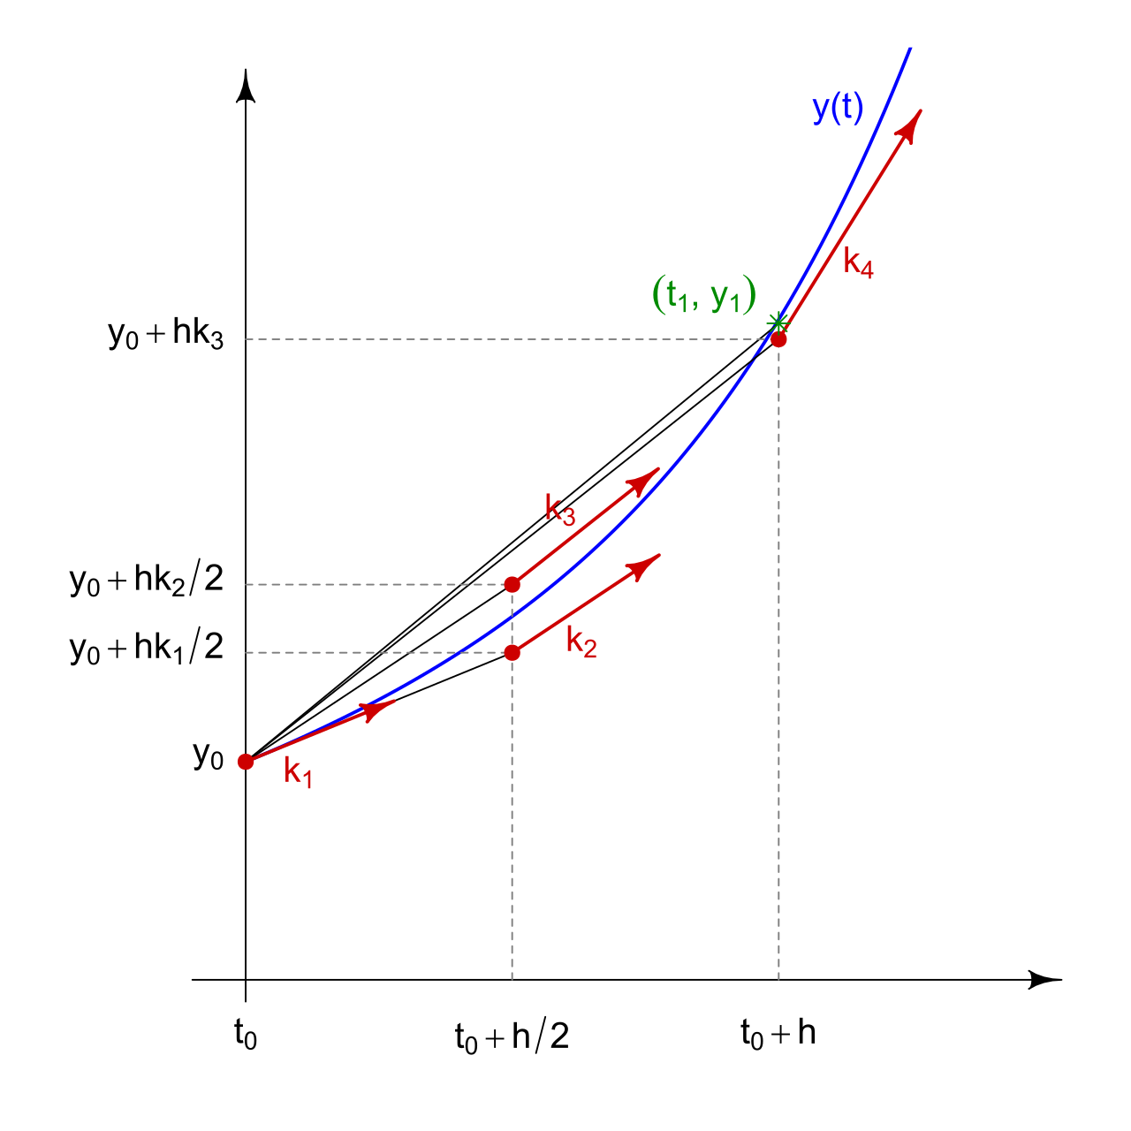
RK4 Algorithm
Adapted from HilberTraum - Own work, CC BY-SA 4.0, https://commons.wikimedia.org/w/index.php?curid=64366870
Notes:
\setlength{\textwidth}{7in}
\noindent The numerical integration routine can be written as
\begin{align*}
x_0 &= x(t_0) \\
X_1 &= f(x_{k-1}, u_{k-1}) \\
X_2 &= f(x_{k-1} + \frac{T_s}{2}X_1, u_{k-1}) \\
X_3 &= f(x_{k-1} + \frac{T_s}{2}X_2, u_{k-1}) \\
X_4 &= f(x_{k-1} + T_s X_3, u_{k-1}) \\
x_k &= x_{k-1} + \frac{T_s}{6} (X_1 + 2X_2 + 2X_3 + X_4)
\end{align*}
\noindent This is the Runge-Kutta fourth-order method \\ or RK4

Slide 27
Dynamics and RK4 Implementation
See example code
Notes:
\setlength{\textwidth}{7in}
\noindent The integral on the previous page can be approximated as
\[
\int_{t-T_s}^t f(x(\tau), u(\tau))\,d\tau \approx T_s f(x(t-T_s), u(t-T_s)).
\]
\vspace{4cm}
\noindent Resulting in
\[
x_k = x_{k-1} + T_s f(x_{k-1}, u_{k-1}), \quad x_0 = x(t_0).
\]
This is the Runge-Kutta first order method, or RK1.

Slide 28
Project
Notes:
\begin{enumerate}
\item
Implement the MAV equations of motion given in Equations~(3.14) through (3.17). Assume that the inputs to the block are the forces and moments applied to the MAV in the body frame. Changeable parameters should include the mass, the moments and products of inertia, and the initial conditions for each state. Use the parameters given in Appendix~E.
\item Verify that the equations of motion are correct by individually setting the forces and moments along each axis to a nonzero value and convincing yourself that the motion is appropriate.
\item
Since $J_{xz}$ is non-zero, there is gyroscopic coupling between roll and yaw. To test your simulation, set $J_{xz}$ to zero and
place nonzero moments on $l$ and $n$ and verify that there is no coupling between the roll and yaw axes. Verify that when $J_{xz}$ is not zero, there is coupling between the roll and yaw axes.
\end{enumerate}

